Slide 1
RCHG: LMS Analytics Strategy and Predictive Performance Reporting
By Group 3:
Elena Losavio
Tongai Zinaka
Ciruthika Nithusyanthan
Aamina Patel

Slide 2
The Business Problem
In line with their goal to develop their human capital, Rychtenshane Community Housing Group (RCHG) is preparing to launch its first Learning Management System (LMS) to centralize learning efforts and leverage data-driven insights to improve staff training, compliance, and performance outcomes.
Our responsibility was to analyze LMS data, model it for enterprise reporting, derive insights, and apply predictive and inferential statistical techniques (including forecasting, regression analysis, and ANOVA) to inform strategic decisions.

Slide 3







Approach and Tools Used
Responsibilities were distributed based on each team member’s expertise, previous commitments and time availability. The tools below were then used to help maintain visibility and open communication between the members.
Jira – shared dashboard to manage tasks
Zoom – daily stand-up meetings were held to update one another, raise concerns and support shared decision-making
Slack – post recaps for any teammates who missed a zoom session, raise any concerns and provide feedback
Power BI – clean, model and build the dashboard
Excel – for ANOVA calculation
Notion – write up business insight report
GitHub – shared repository used to share our work

Slide 4
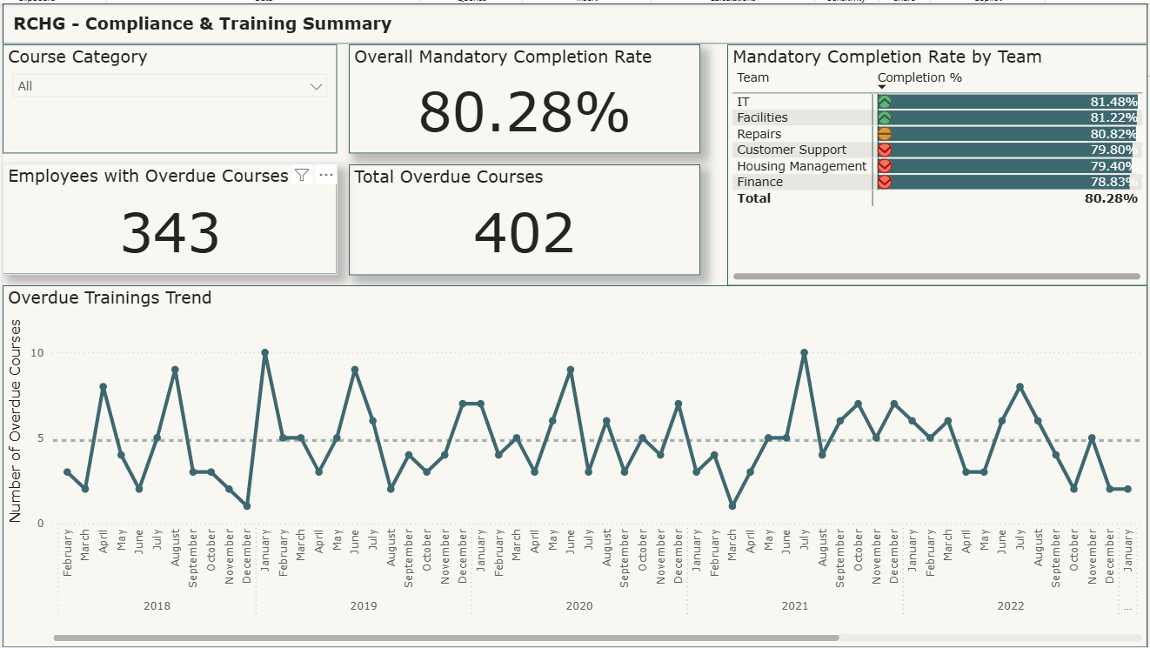
Key Insights and Results Compliance & Training Summary
Compliance risk is rising → 402 courses overdue, e.g. 102 in compliance training, with the Finance team trailing at just 78.8% completion rate
For Finance, the lag in compliance training could result in regulatory fines if standards aren’t maintained
For Housing Management and Repairs, the concern is more about safety. If properties aren't kept to proper standards or staff aren’t adequately trained, there could be real dangers to tenants; especially in areas connected to Health & Safety, which currently has 75 outstanding courses.
Strengthen compliance training where risk is highest
Prioritize overdue compliance and health & safety courses for teams with operational or regulatory exposure, especially Finance, Housing Management and Repairs
Introduce automated reminders and manager-led follow-ups to ensure completion

Slide 5
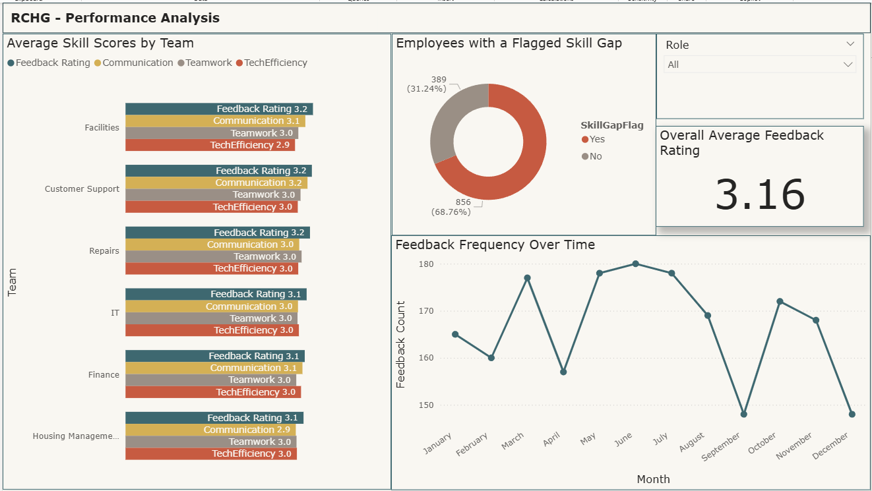
Key Insights and Results Performance Analysis
Major skill gaps across the workforce → 69% of employees show training gaps, opening doors for specialized upskilling by role and department
Seasonal windows boost learning → Feedback and engagement peak from May to August, ideal timing for new course rollouts
Launch targeted skills development
Use the identified 69% skill gap to guide targeted training: align specialized content to team needs (e.g. technical modules for IT, communication for support teams)
Run pulse surveys to gather employee input on desired development areas
Notes:
Analysis of feedback frequency reveals a substantial decline in December, likely attributed to the busy end-of-year period and holiday season. Similarly, September shows a drop in engagement, possibly due to seasonal workload increases related to student accommodation demands within the housing sector.
Conversely, from May through August, feedback volume is markedly higher, suggesting that the relative lull in the housing market may offer employees more flexibility to participate in training. This period may represent a strategic window for course delivery.

Slide 6
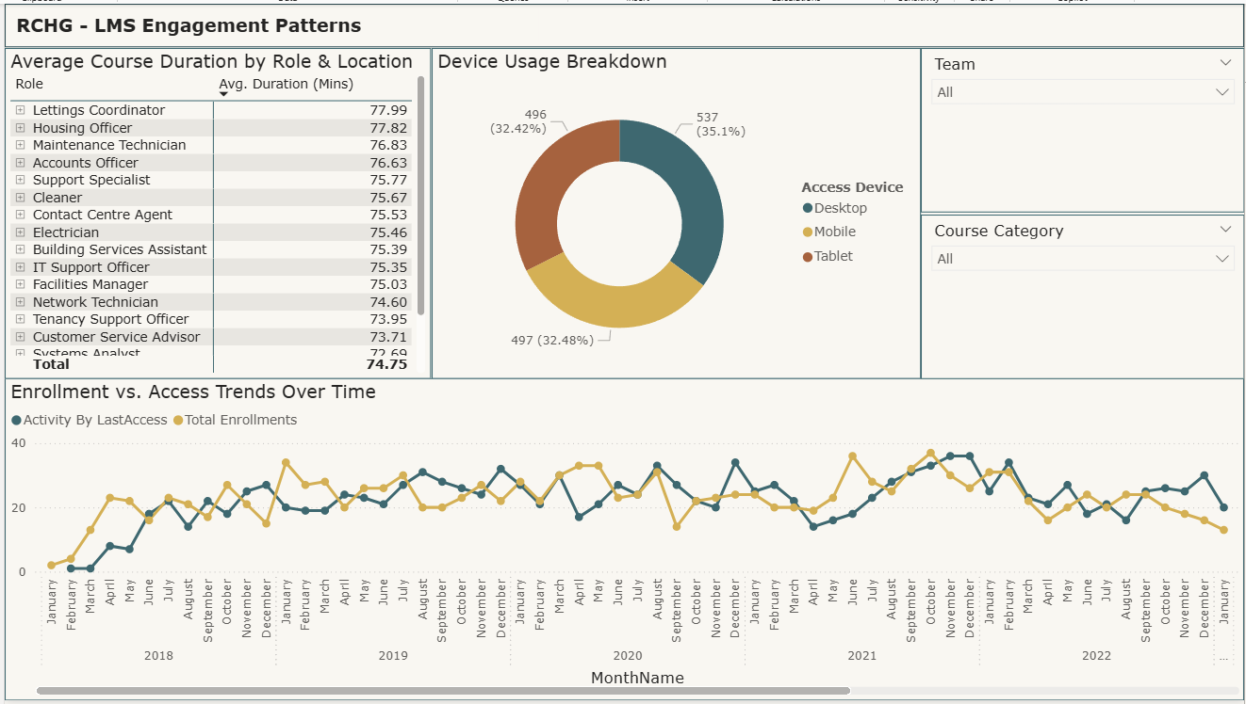
Key Insights and Results Engagement Patterns
Course length impacts completion → Modules over 75 minutes see fewer completions, especially in Housing roles; shorter formats prove more effective
Focus is on completion not ongoing learning → Enrolments volumes have remained stable over the past five years, however, a persistent gap between enrolments and actual access behaviour suggests many users interact with the LMS only briefly or as a one-time activity.
Notably, the last quarter experienced a sharper-than-usual decline in engagement, signalling a possible shift in user behaviour or external factors that should be examined further.
Enhance engagement by reducing passive use
Bridge the gap between enrolment and active participation by introducing lightweight onboarding flows, nudges, and microlearning incentives
Investigate why users are disengaging (especially in recent quarters)and address barriers
Notes:
The average course duration sits at 75 minutes, ranging narrowly between 70 and 78 minutes. Although the time variation seems minimal, deeper analysis reveals a stronger impact when cross-referenced with completion data. Specifically, longer courses (particularly those tied to housing management roles such as Lettings Coordinator and Housing Officer) correlate with lower completion rates. In contrast, IT and Facilities teams demonstrate higher completion rates, supported by shorter course lengths. Interestingly, the Finance team shows low completion rates despite shorter course durations, indicating that additional factors may be influencing engagement, warranting further investigation.

Slide 7
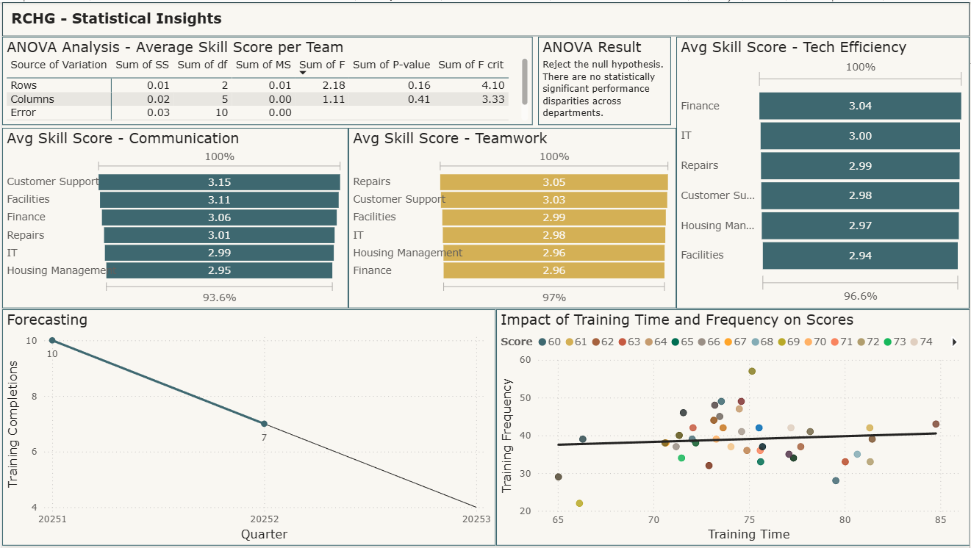
Key Insights and Results Statistical Insights
Training completions forecasted to decline → Q1 2025, 10 training courses were completed, followed by 7 in Q2, a downward trend suggests a projected participation of 4 courses in Q3
Time and frequency positively impact scores → about 40 accesses tends to yield the highest scores and top-performing individuals complete their courses in 70 to 80 minutes, matching the average course duration
Performance disparities across departments not statistically significant → ANOVA results show no statistically significant differences in skill scores across teams or roles
Monitor learning impact without overload
Encourage engagement frequency around the 40-access mark, as higher repetition doesn’t correlate with improved review scores
Promote clarity and confidence in course content to reduce reliance on multiple revisits
Notes:
While this aligns with a noted decline in engagement, historical data shows that course participation is largely ad hoc rather than consistently sustained. Therefore, this shift doesn’t yet indicate a major concern, though it warrants monitoring. Only Q1 and Q2 2025 data were used to inform this forecast, as prior historical data patterns are too irregular and fragmented to yield meaningful projections. The inconsistency in past participation renders long-term forecasting unreliable, reinforcing the focus on recent trends for short-term planning.

Slide 8
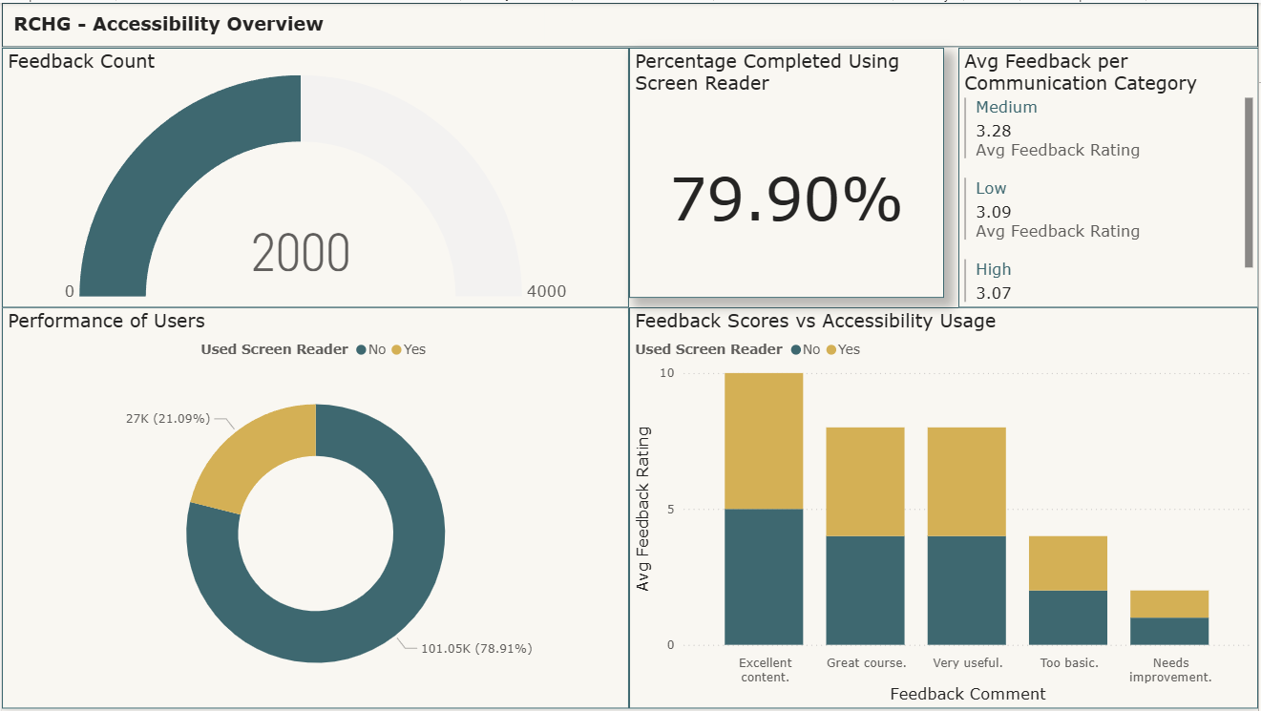
Key Insights and Results Accessibility Overview
Accessible but room to grow → 20% of users rely on screen readers and report similar satisfaction as nonusers, but average feedback scores suggest content tailoring and user support might need refinement
Low feedback scores not due to accessibility → lower ratings may stem from other factors: such as content relevance or support availability
Ensure UI focus and accessibility continuity
Continue optimizing the desktop interface, the most-used format, but maintain full support for tablet and mobile usage
Preserve screen reader functionality, and explore opportunities to enhance inclusivity by engaging neurodiverse users in design feedback
Notes:
Approximately 80% of employees do not use a screen reader, while 20% do, showing why it is vital to keep the platform accessible for all users. When examining feedback ratings across this divide, screen reader users are evenly distributed across the full spectrum of scores (1 to 5), aligning closely with non-users. This suggests that screen reader usage is not a determining factor in positive or negative feedback. Otherwise, we would expect clustering at one end of the scale. This trend speaks to the effectiveness of the screen reader interface and the inclusivity of the training experience overall.
At the same time, the absence of negative bias linked to screen reader usage presents an opportunity for reflection. If the interface is not a source of dissatisfaction, lower ratings may stem from other factors: such as content relevance or support availability. These insights suggests we should look more closely at why it is happening to ensure design enhancements continue to meet varied accessibility needs.

Slide 9
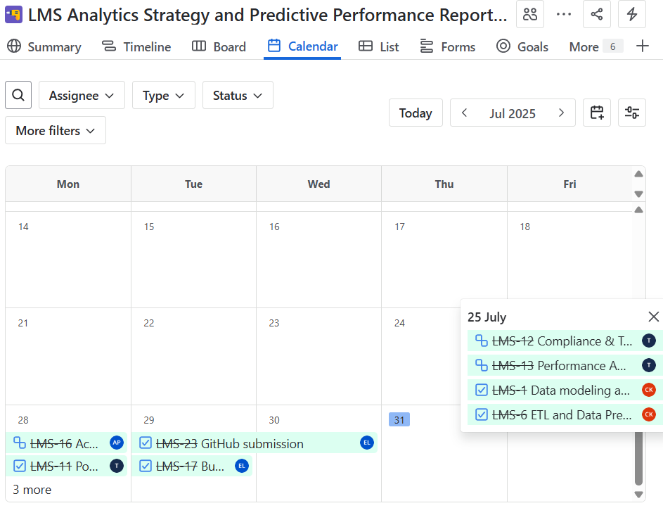
Individual Team Member Contributions
Elena Losavio compiled the business insight report, coordinated meetings and stand-ups, set up the Jira dashboard, and supported the team through planning and project alignment
Tongai Zinaka built the Power BI dashboard, including compliance & training, performance and engagement views
Ciruthika Nithusyanthan built a comprehensive data model, by designing a snowflake schema to support flexible slicing and advanced analytics across multiple dimensions
Aamina Patel contributed statistical insights (forecasting, regression, ANOVA) and an accessibility overview

Slide 10
Challenges Faced and Resolutions
Team Member | Challenge | Resolution
Elena Losavio | Translating technical data into a compelling narrative for a non-specialist audience | Isolating key data points and building a clear strategic message, then returned to the team with follow up questions to deepen the analysis and incorporate feedback
Tongai Zinaka | Date dimension table, which appeared non-functional despite correct formatting and underlying data | Derived month and year categories manually
Ciruthika Nithusyanthan | Initial difficulties managing multiple date relationships (e.g. EnrolmentDate, CompletionDate, LastAccessDate) Assigning EmployeeHistoryID to fact records also posed a challenge due to the absence of clear promotion and transfer dates | Implemented a single DimDate table with several inactive relationships, which were selectively activated in DAX using the USERELATIONSHIP() function Generated surrogate keys using a combination of employee attributes (EmployeeID, Role, Location, and Team) and performed mappings through Power Query merges
Aamina Patel | Unfamiliar with ANOVA analysis | Learning the concept from scratch using AI tools and YouTube. Initially attempted the process in Power BI but ultimately optimized workflow by utilizing Excel’s built-in ANOVA functions for calculations, later exporting the results back into Power BI

